Slide 1
Pressure Around Us
Katie Olfert
UBC Physics and Computer Science

Slide 2
What is pressure?
Pressure is how much something pushes
at a given point on a surface.

Slide 3
Changing Pressure
Adding/removing particles

Slide 4
Changing Pressure
Adding/removing particles
Changing size of container

Slide 5
Changing Pressure
Adding/removing particles
Changing size of container
Adding/removing energy

Slide 6
Pressure in Action

Slide 7
Air Pressure in a Tire

Slide 8
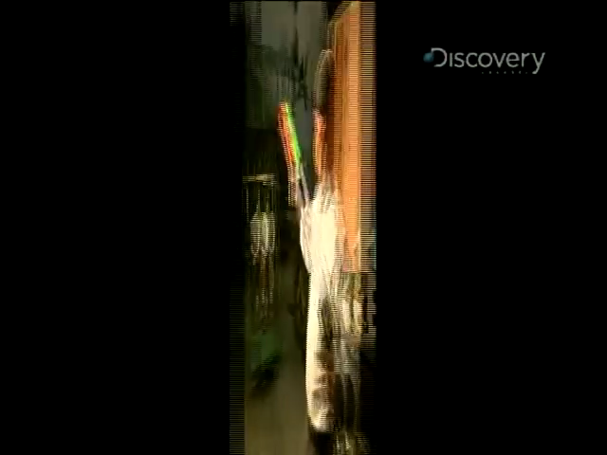
Water Guns

Slide 9
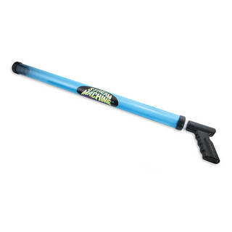
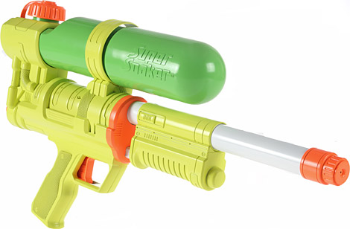
Water Guns

Slide 10
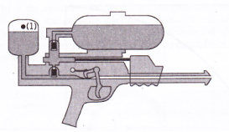

Water Guns

Slide 11
Pressure Cooking!

Slide 12
DEMONSTRATIONS
Cooking with Pressure
Stir Stick Smack
Poking Bottles
Upside-down Flask

Slide 13
DEMONSTRATIONS
Cooking with Pressure
Stir Stick Smack
Poking Bottles
Upside-down Flask

Slide 14
Explanation

Slide 15
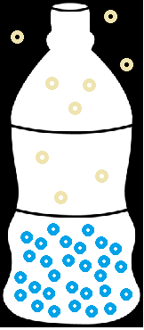
Open Lid
Poke a Hole

Slide 16
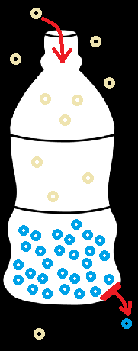
Open Lid
Poke a Hole

Slide 17
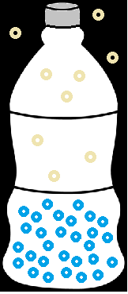
Closed Lid
Poke a Hole

Slide 18
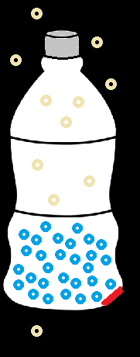
Closed Lid
Poke a Hole

Slide 19
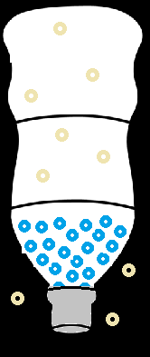
Larger Holes
Remove Cap

Slide 20
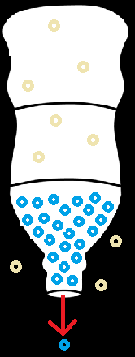
Larger Holes
Remove Cap

Slide 21
DEMONSTRATIONS
Cooking with Pressure
Stir Stick Smack
Poking Bottles
Upside-down Flask

Slide 22
Explanation

Slide 23
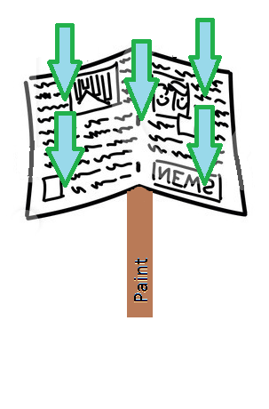
Atmospheric Pressure

Slide 24
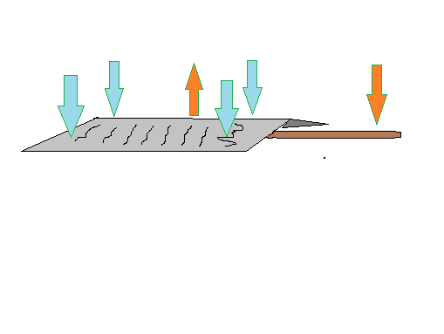
Atmospheric Pressure

Slide 25
DEMONSTRATIONS
Cooking with Pressure
Stir Stick Smack
Poking Bottles
Upside-down Flask

Slide 26
Explanation

Slide 27
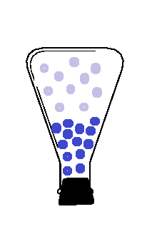
Lower Pressure

Slide 28
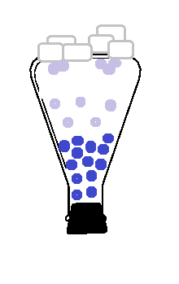
Lower Pressure

Slide 29
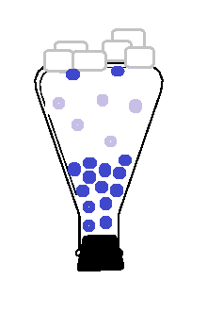
Lower Pressure

Slide 30
DEMONSTRATIONS
Cooking with Pressure
Stir Stick Smack
Poking Bottles
Upside-down Flask

Slide 31
Explanation

Slide 32
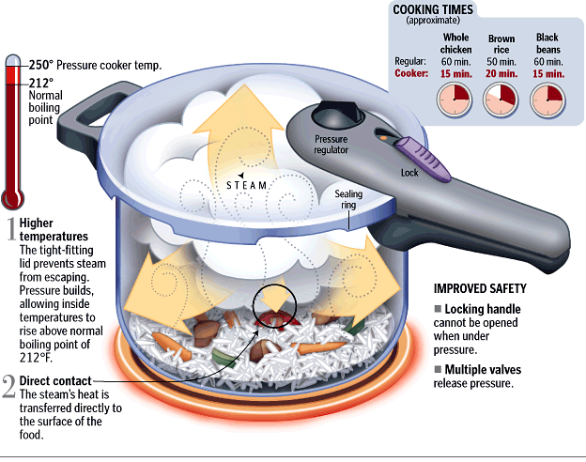

Slide 33
Have a good day!

